Slide 1
CCNA Security
Chapter One
Modern Network Security Threats

Slide 2
Lesson Planning
This lesson should take 3-6 hours to present
The lesson should include lecture, demonstrations, discussion and assessment
The lesson can be taught in person or using remote instruction

Slide 3
Major Concepts
Rationale for network security
Data confidentiality, integrity, availability
Risks, threats, vulnerabilities and countermeasures
Methodology of a structured attack
Security model (McCumber cube)
Security policies, standards and guidelines
Selecting and implementing countermeasures
Network security design

Slide 4
Lesson Objectives
Upon completion of this lesson, the successful participant will be able to:
Describe the rationale for network security
Describe the three principles of network security
Identify risks, threats, vulnerabilities and countermeasures
Discuss the three states of information and identify threats and appropriate countermeasures for each state
Differentiate between security policies, standards and guidelines

Slide 5
Lesson Objectives
Describe the difference between structured and unstructured network attacks
Describe the stages and tools used in a structured attack
Identify security organizations that influence and shape network security
Identify career specializations in network security

Slide 6

What is Network Security?
National Security Telecommunications and Information Systems Security Committee (NSTISSC)
Network security is the protection of information and systems and hardware that use, store, and transmit that information.
Network security encompasses those steps that are taken to ensure the confidentiality, integrity, and availability of data or resources.

Slide 7

Rationale for Network Security
Network security initiatives and network security specialists can be found in private and public, large and small companies and organizations. The need for network security and its growth are driven by many factors:
Internet connectivity is 24/7 and is worldwide
Increase in cyber crime
Impact on business and individuals
Legislation & liabilities
Proliferation of threats
Sophistication of threats

Slide 8
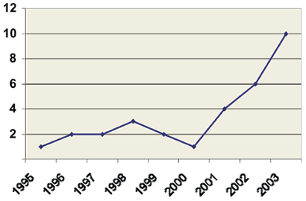
Cyber Crime
Fraud/Scams
Identity Theft
Child Pornography
Theft of Telecommunications Services
Electronic Vandalism, Terrorism and Extortion
WASHINGTON, D.C. –– An estimated 3.6 million households, or about 3 percent of all households in the nation, learned that they had been the victim of at least one type of identity theft during a six-month period in 2004, according to the Justice Department’s Bureau of Justice Statistics

Slide 9
Business Impact
Current Computer Crime Cases
Link
Decrease in productivity
Loss of sales revenue
Release of unauthorized sensitive data
Threat of trade secrets or formulas
Compromise of reputation and trust
Loss of communications
Threat to environmental and safety systems
Loss of time

Slide 10

Proliferation of Threats
The Top Cyber Security Risks - http://www.sans.org/top20/ .
Since that time, thousands of organizations rely on this list to prioritize their efforts so they can close the most dangerous holes first.
The threat landscape is very dynamic, which in turn makes it necessary to adopt newer security measures.
Just over the last few years, the kinds of vulnerabilities that are being exploited are very different from the ones being exploited in the past.
http://technet.microsoft.com/en-us/security/bulletin/ms11-aug

Slide 11
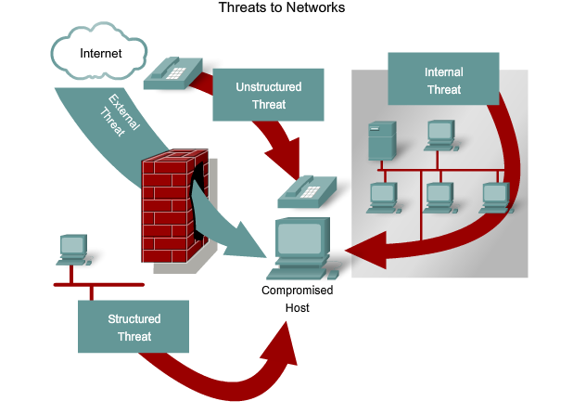
Sophistication of Threats

Slide 12
Legislation
Federal and local government has passed legislation that holds organizations and individuals liable for mismanagement of sensitive data. These laws include:
The Health Insurance Portability and Accountability Act of 1996 (HIPAA)
The Sarbanes-Oxley Act of 2002 (Sarbox)
The Gramm-Leach-Blilely Act (GLBA)
US PATRIOT Act 2001

Slide 13

Goals of an Information Security Program
Confidentiality
Prevent the disclosure of sensitive information from unauthorized people, resources, and processes
Integrity
The protection of system information or processes from intentional or accidental modification
Availability
The assurance that systems and data are accessible by authorized users when needed

Slide 14
Information Security Model
Information States
Information Security Properties
Security Measures
NSTISSI 4011: National Training Standard for Information Systems Security Professionals, 1994

Slide 15
Information Security Properties
Confidentiality
Integrity
Availability

Slide 16
Information States
Processing
Storage
Transmission

Slide 17
Security Measures
Policy and Procedures
Technology
Education, Training, and Awareness

Slide 18
Information Security Model
Processing
Storage
Transmission
Confidentiality
Integrity
Availability
Policy and Procedures
Technology
Education, Training, and Awareness

Slide 19
Risk Management
Risk Analysis
Threats
Vulnerabilities
Countermeasures

Slide 20
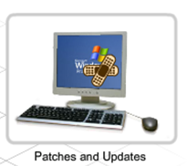


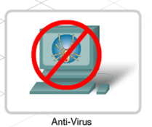
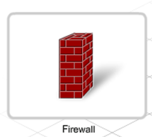
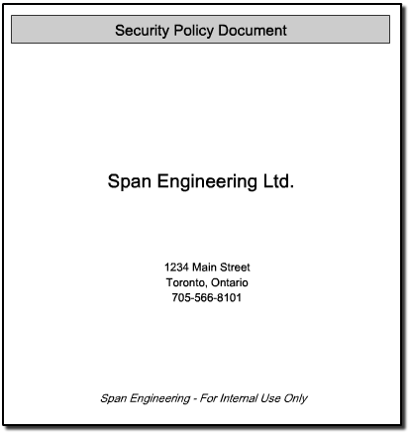
Risk Management
Control physical access
Password protection
Develop a Security Policy
The process of assessing and quantifying risk and establishing an acceptable level of risk for the organization
Risk can be mitigated, but cannot be eliminated

Slide 21
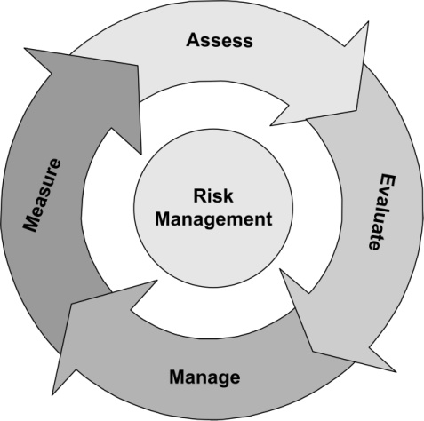
Risk Assessment
Risk assessment involves determining the likelihood that the vulnerability is a risk to the organization
Each vulnerability can be ranked by the scale
Sometimes calculating anticipated losses can be helpful in determining the impact of a vulnerability

Slide 22
Asset Identification
Categories of assets
Information Assets (people, hardware, software, systems)
Supporting Assets (facilities, utilities, services)
Critical Assets (can be either of those listed above)
Attributes of the assets need to be compiled
Determine each item’s relative value
How much revenue/profit does it generate?
What is the cost to replace it?
How difficult would it be to replace?
How quickly can it be replaced?

Slide 23
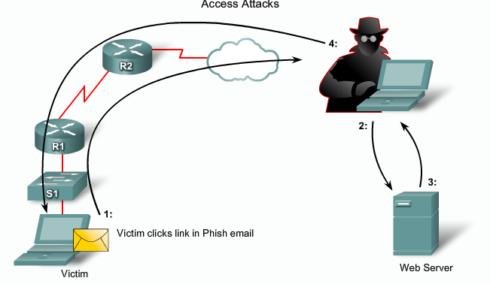
Network Security “Threat”
A potential danger to information or a system
An example: the ability to gain unauthorized access to systems or information in order to commit fraud, network intrusion, industrial espionage, identity theft, or simply to disrupt the system or network
There may be weaknesses that greatly increase the likelihood of a threat manifesting
Threats may include equipment failure, structured attacks, natural disasters, physical attacks, theft, viruses and many other potential events causing danger or damage

Slide 24

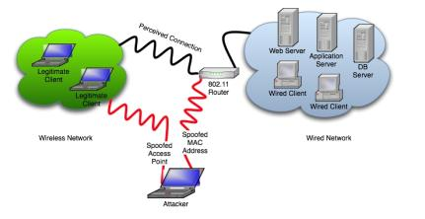
Types of Network Threats
Impersonation
Eavesdropping
Denial-of-service
Packet replay
Man-in-the-middle
Packet modification

Slide 25
Vulnerability
A network vulnerability is a weakness in a system, technology, product or policy
In today’s environment, several organizations track, organize and test these vulnerabilities
The US government has a contract with an organization to track and publish network vulnerabilities
Each vulnerability is given an ID and can be reviewed by network security professionals over the Internet.
The common vulnerability exposure (CVE) MITRE.org list also publishes ways to prevent the vulnerability from being attacked
NBÚ SR http://www.nbusr.sk/

Slide 26
Vulnerability Appraisal
It is very important that network security specialists comprehend the importance of vulnerability appraisal
A vulnerability appraisal is a snapshot of the current security of the organization as it now stands
What current security weaknesses may expose the assets to these threats?
Vulnerability scanners are tools available as free Internet downloads and as commercial products
These tools compare the asset against a database of known vulnerabilities and produce a discovery report that exposes the vulnerability and assesses its severity
http://sectools.org/vuln-scanners.html

Slide 27
Risk Management Terms
Vulnerability – a system, network or device weakness
Threat – potential danger posed by a vulnerability
Threat agent – the entity that indentifies a vulnerability and uses it to attack the victim
Risk – likelihood of a threat agent taking advantage of a vulnerability and the corresponding business impact
Exposure – potential to experience losses from a threat agent
Countermeasure – put into place to mitigate the potential risk

Slide 28
Understanding Risk
Gives rise to
Threat
Agent
Exploits
Threat
Leads to
Vulnerability
Risk
Directly affects
Asset
Can damage
Exposure
Causes
Countermeasure
Can be safeguarded by

Slide 29
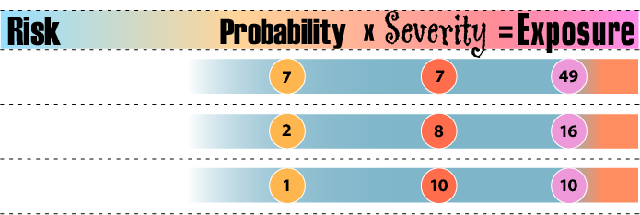
Qualitative Risk Analysis
Probability
x
Severity
Exposure
=
Exposure values prioritize the order for addressing risks
Risk
Probability
Severity
Exposure
A new worm
Web site defacement
Fire protection system
Floods datacenter

Slide 30
Quantitative Risk Analysis
Exposure Factor (EF)
% of loss of an asset
Single Loss Expectancy (SLE)
EF x Value of asset in $
Annualized Rate of Occurrence (ARO)
A number representing frequency of occurrence of a threat
Example: 0.0 = Never 1000 = Occurs very often
Annualized Loss Expectancy (ALE)
Dollar value derived from: SLE x ARO

Slide 31
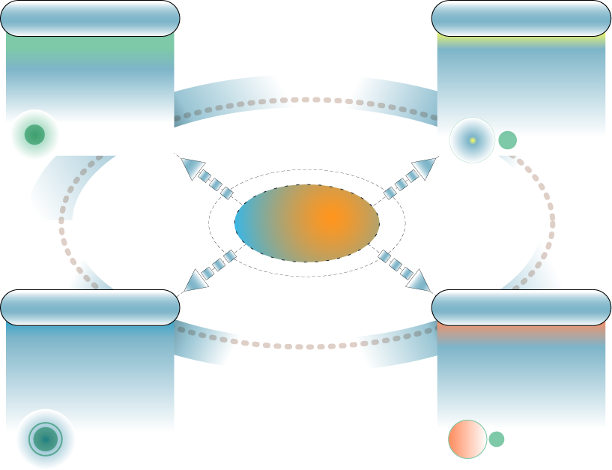
Managing Risks
Accept
Transfer
Acknowledge that the risk exists, but apply no safeguard
Shift responsibility for the risk to a third party (ISP, Insurance, etc.)
Risk
Mitigate
Avoid
Change the asset’s risk exposure (apply safeguard)
Eliminate the asset’s exposure to risk, or eliminate the asset altogether

Slide 32
Types of Attacks
Structured attack
Come from hackers who are more highly motivated and technically competent. These people know system vulnerabilities and can understand and develop exploit code and scripts. They understand, develop, and use sophisticated hacking techniques to penetrate unsuspecting businesses. These groups are often involved with the major fraud and theft cases reported to law enforcement agencies.
Unstructured attack
Consists of mostly inexperienced individuals using easily available hacking tools such as shell scripts and password crackers. Even unstructured threats that are only executed with the intent of testing and challenging a hacker’s skills can still do serious damage to a company.

Slide 33
Types of Attacks
External attacks
Initiated by individuals or groups working outside of a company. They do not have authorized access to the computer systems or network. They gather information in order to work their way into a network mainly from the Internet or dialup access servers.
Internal attacks
More common and dangerous. Internal attacks are initiated by someone who has authorized access to the network. According to the FBI, internal access and misuse account for 60 to 80 percent of reported incidents. These attacks often are traced to disgruntled employees.

Slide 34
Types of Attacks
Passive Attack
Listen to system passwords
Release of message content
Traffic analysis
Data capturing
Active Attack
Attempt to log into someone else’s account
Wire taps
Denial of services
Masquerading
Message modifications

Slide 35
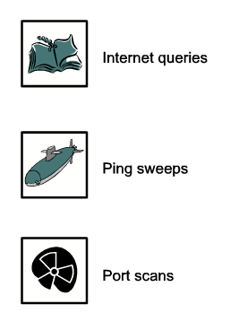
Specific Network Attacks
ARP Attack
Brute Force Attack
Worms
Flooding
Sniffers
Spoofing
Redirected Attacks
Tunneling Attack
Covert Channels

Slide 36

Denial-of-Service Facts
Uh-Oh. Another DoS attack!
Commonly used against information stores like web sites
Simple and usually quite effective
Does not pose a direct threat to sensitive data
The attacker tries to prevent a service from being used and making that service unavailable to legitimate users
Attackers typically go for high visibility targets such as the web server, or for infrastructure targets like routers and network links

Slide 37
Denial-of-Service Example
If a mail server is capable of receiving and delivering 10 messages a second, an attacker simply sends 20 messages per second. The legitimate traffic (as well as a lot of the malicious traffic) will get dropped, or the mail server might stop responding entirely.
This type of an attack may be used as a diversion while another attack is made to actually compromise systems
In addition, administrators are likely to make mistakes during an attack and possibly change a setting that creates a vulnerability that can be further exploited

Slide 38
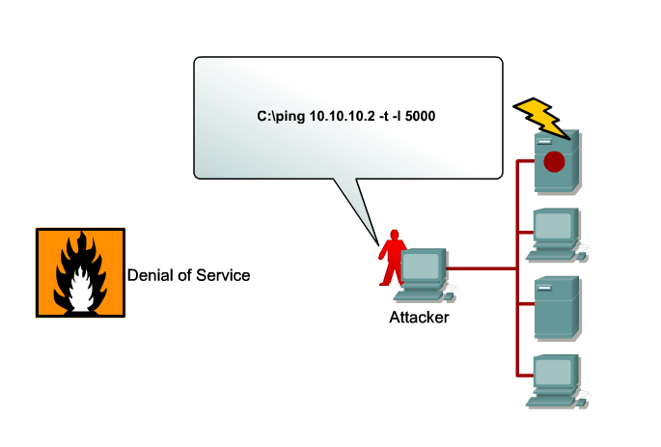
Types of Denial-of-Service Attacks
Buffer Overflow Attacks
SYN Flood Attack
Teardrop Attacks
Smurf Attack
DNS Attacks
Email Attacks
Physical Infrastructure Attacks
Viruses/Worms

Slide 39
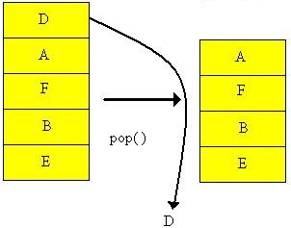
DoS - Buffer Overflow Attacks
The most common DoS attack sends more traffic to a device than the program anticipates that someone might send Buffer Overflow.

Slide 40
DoS - SYN Flood Attack
When connection sessions are initiated between a client and server in a network, a very small space exists to handle the usually rapid "hand-shaking" exchange of messages that sets up a session.
The session-establishing packets include a SYN field that identifies the sequence order.
To cause this kind of attack, an attacker can send many packets, usually from a spoofed address, thus ensuring that no response is sent.

Slide 41
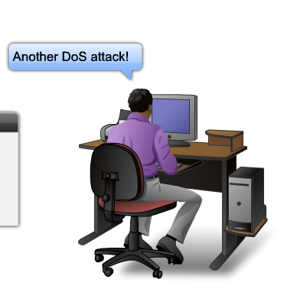
DoS - Teardrop Attack
Exploits the way that the Internet Protocol (IP) requires a packet that is too large for the next router to handle be divided into fragments.
The fragmented packet identifies an offset to the beginning of the first packet that enables the entire packet to be reassembled by the receiving system.
In the teardrop attack, an attacker's IP puts a confusing value in the second or later fragment. If the receiving operating system cannot cope with such fragmentation, then it can cause the system to crash.

Slide 42
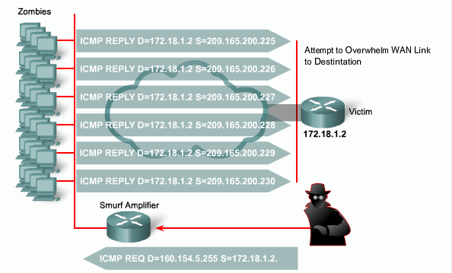
DoS - Smurf Attack
The attacker sends an IP ping request to a network site.
The ping packet requests that it be broadcast to a number of hosts within that local network.
The packet also indicates that the request is from a different site, i.e. the victim site that is to receive the denial of service.
This is called IP Spoofing--the victim site becomes the address of the originating packet.
The result is that lots of ping replies flood back to the victim host. If the flood is big enough then the victim host will no longer be able to receive or process "real" traffic.

Slide 43
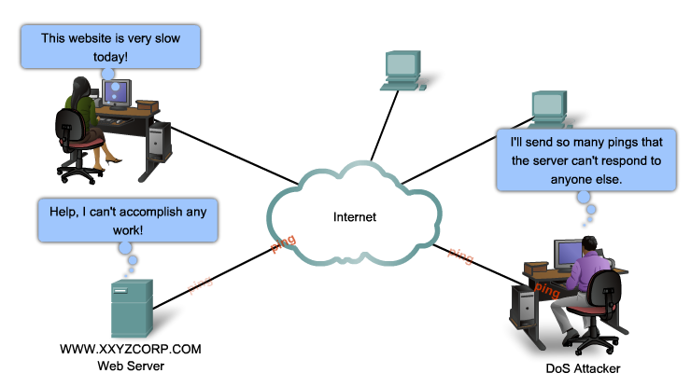
DoS - DNS Attacks
A famous DNS attack was a DDoS "ping" attack. The attackers broke into machines on the Internet (popularly called "zombies") and sent streams of forged packets at the 13 DNS root servers via intermediary legitimate machines.
The goal was to clog the servers, and communication links on the way to the servers, so that useful traffic was gridlocked. The assault is not DNS-specific--the same attack has been used against several popular Web servers in the last few years.
Notes:
The domain name system--the global directory that maps names to Internet Protocol addresses.

Slide 44

DoS - Email Attacks
When using Microsoft Outlook, a script reads your address book and sends a copy of itself to everyone listed there, thus propagating itself around the Internet.
The script then modifies the computer’s registry so that the script runs itself again when restarted.
Notes:
The ILOVEYOU virus is an example of an email attack. The text portion of the email message asks you to open the attachment.

Slide 45


DoS - Physical Infrastructure Attacks
Someone can just simply snip your cables! Fortunately this can be quickly noticed and dealt with.
Other physical infrastructure attacks can include recycling systems, affecting power to systems and actual destruction of computers or storage devices.

Slide 46
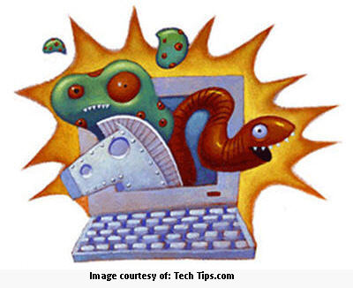
DoS - Viruses/Worms
Viruses or worms, which replicate across a network in various ways, can be viewed as denial-of-service attacks where the victim is not usually specifically targeted but simply a host unlucky enough to get the virus.
Available bandwidth can become saturated as the virus/worm attempts to replicate itself and find new victims.
Notes:
This type of DoS attack can range from not noticeable to show-stopper depending on the characteristics of the virus/worm.

Slide 47
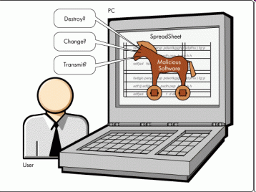
Malicious Code Attacks
Malicious code attacks refers to viruses, worms, Trojan horses, logic bombs, and other uninvited software
Damages personal computers, but also attacks systems that are more sophisticated
Actual costs attributed to the presence of malicious code have resulted primarily from system outages and staff time involved in repairing the systems
Costs can be significant

Slide 48
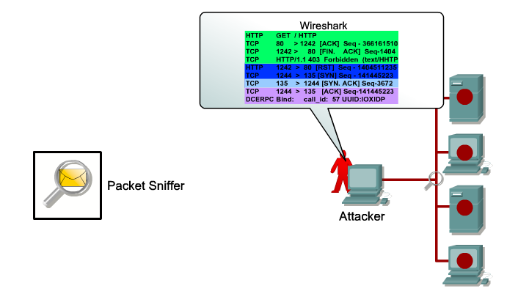
Packet Sniffing Attacks
Most organization LANs are Ethernet networks
On Ethernet-based networks, any machine on the network can see the traffic for every machine on that network
Sniffer programs exploit this characteristic, monitoring all traffic and capturing the first 128 bytes or so of every unencrypted FTP or Telnet session (the part that contains user passwords)
Trošku si pomôžeme - Catalyst Switched Port Analyzer (SPAN)

Slide 49
Information Leakage Attacks
Attackers can sometimes get data without having to directly use computers
Exploit Internet services that are intended to give out information
Induce these services to reveal extra information or to give it out to unauthorized people
Many services designed for use on local area networks do not have the security needed for safe use across the Internet
Thus these services become the means for important information leakage

Slide 50
Social Engineering Attacks
Hacker-speak for tricking a person into revealing some confidential information
Social Engineering is defined as an attack based on deceiving users or administrators at the target site
Done to gain illicit access to systems or useful information
The goals of social engineering are fraud, network intrusion, industrial espionage, identity theft, etc.
Notes:
Typically carried out by telephoning users or operators and pretending to be an authorized user or an administrator

Slide 51
Attack Methodology
Stages - the methodology of network attacks is well documented and researched. This research has led to greater understanding of network attacks and an entire specialization of engineers that test and protect networks against attacks (Certified Ethical Hackers/Penetration Testers)
Tools - penetration testers have a variety of power tools that are now commercially available. They also have may open source free tools. This proliferation of powerful tools has increased the threat of attack due to the fact that even technical novices can now launch sophisticated attacks.

Slide 52
Stages of an Attack
Today’s attackers have a abundance of targets. In fact their greatest challenge is to select the most vulnerable victims. This has resulted in very well- planned and structured attacks. These attacks have common logistical and strategic stages. These stages include;
Reconnaissance
Scanning (addresses, ports, vulnerabilities)
Gaining access
Maintaining Access
Covering Tracks

Slide 53
Tools of the Attacker
The following are a few of the most popular tools used by network attackers:
Enumeration tools (dumpreg, netview and netuser)
Port/address scanners (AngryIP, nmap, Nessus)
Vulnerability scanners (Meta Sploit, Core Impact, ISS)
Packet Sniffers (Snort, Wire Shark, Air Magnet)
Root kits
Cryptographic cracking tools (Cain, WepCrack)
Malicious codes (worms, Trojan horse, time bombs)
System hijack tools (netcat, MetaSploit, Core Impact)

Slide 54
Usefull stuff
Penetration testers
Samurai web testing, framework walk through, inspect pro, lynis, metasploit
Password storage
Password safe, kepass password safe, sticky password, Easy Password keeper
Password cracker
Brutus AET2 password cracker, 0phCrack

Slide 55
Countermeasures
DMZ/NAT
IDS/IPS
Content Filtering/NAC
Firewalls/proxy services
Authentication/Authorization/Accounting
Self-defending networks
Policies, procedures, standards guidelines
Training and awareness

Slide 56
Countermeasure Selection
Cost /benefit calculation (ALE - Annualized Loss Expectancy)
(ALE before implementing safeguard) – (ALE after implementing safeguard) – (annual cost of safeguard) = value of safeguard to the company
Evaluating cost of a countermeasure
Product costs
Design/planning costs
Implementation costs
Environment modifications
Compatibility
Maintenance requirements
Testing requirements
Repair, replacement, or update costs
Operating and support costs
Effects of productivity

Slide 57

Security Administration
Policies
Standards
Guidelines
Procedures
Baselines
Domains of Network Security
Risk Assessment
Security Policy
Organization of Information Security
Asset Management
Human Resources Security
Physical and Environmental Security
Communications and Operations Management
Access Control
Information Systems Acquisition, Development and Maintenance
Information Security Incident Management
Business Continuity Management
Compliance

Slide 58




What Is a Security Policy?
A document that states how an organization plans to protect its tangible and intangible information assets
Management instructions indicating a course of action, a guiding principle, or appropriate procedure
High-level statements that provide guidance to workers who must make present and future decisions
Generalized requirements that must be written down and communicated to others

Slide 59
Change Drivers
Built into the information security program
Events that cause us to revisit policies, procedures, standards, and guidelines
Changes in technology
Changes in senior level personnel
Acquisition of other companies
New products, services, or business lines

Slide 60

Documents Supporting Policies
Standards – dictate specific minimum requirements in our policies
Guidelines – suggest the best way to accomplish certain tasks
Procedures – provide a method by which a policy is accomplished (the instructions)

Slide 61
Example: The Policy
All users must have a unique user ID and password that conforms to the company password standard
Users must not share their password with anyone regardless of title or position
Passwords must not be stored in written or any readable form
If a compromise is suspected, it must be reported to the help desk and a new password must be requested

Slide 62
Example: The Standards
Minimum of 8 upper- and lowercase alphanumeric characters
Must include a special character
Must be changed every 30 days
Password history of 24 previous passwords will be used to ensure passwords aren’t reused

Slide 63
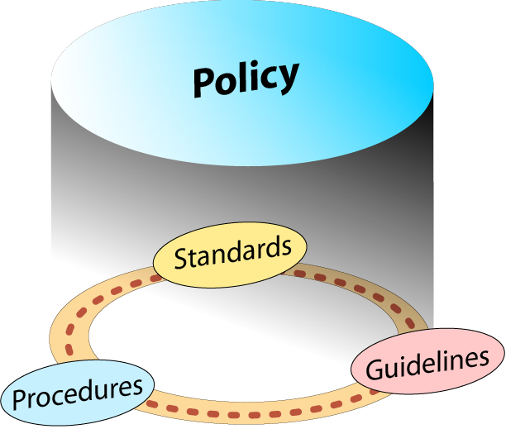
Example: The Guideline
Take a phrase
Up and At ‘em at 7!
Convert to a strong password
Up&atm@7!
To create other passwords from this phrase, change the number, move the symbol, or change the punctuation mark
Password meter

Slide 64

Example: The Procedure
Procedure for changing a password
Press Control, Alt, Delete to bring up the log in dialog box
Click the “change password” button
Enter your current password in the top box
…

Slide 65
Policy Elements
Statement of Authority – an introduction to the information security policies
Policy Headings – logistical information (security domain, policy number, name of organization, effective date, author, change control documentation or number)
Policy Objectives – states what we are trying to achieve by implementing the policy
Policy Statement of Purpose – why the policy was adopted, and how it will be implemented

Slide 66
Policy Elements, 2
Policy Audience – states who the policy is intended for
Policy Statement – how the policy will be implemented (the rules)
Policy Exceptions – special situations calling for exception to the normal, accepted rules
Policy Enforcement Clause – consequences for violation
Policy Definitions – a “glossary” to ensure that the target audience understands the policy

Slide 67
Policy Example
Subsection | 6.1 PERSONNEL SECURITY Change Control #: 1.0
Policy | 6.1.3 Confidentiality Agreements Approved by: SMH
Objectives | Confidentiality of organizational data is a key tenet of our information security program. In support of this goal, ABC Co will require signed confidentiality agreements of all authorized users of information systems. This agreement shall conform to all federal, state, regulatory, and union requirements.
Purpose | The purpose of this policy is to protect the assets of the organization by clearly informing staff of their roles and responsibilities for keeping the organization’s information confidential.
Audience | ABC Co confidentiality agreement policy applies equally to all individuals granted access privileges to an ABC Co Information resources
Policy | This policy requires that staff sign a confidentiality policy agreement prior to being granted access to any sensitive information or systems. Agreements will be reviewed with the staff member when there is any change to the employment or contract, or prior to leaving the organization. The agreements will be provided to the employees by the Human Resource Dept.
Exceptions | At the discretion of the Information Security Officer, third parties whose contracts include a confidentiality clause may be exempted from signing individual confidentiality agreements.
Disciplinary Actions | Violation of this policy may result in disciplinary actions, which may include termination for employees and temporaries; a termination of employment relations in the case of contractors or consultants; or dismissal for interns and volunteers. Additionally, individuals are subject to civil and criminal prosecution.

Slide 68






Network Security Organizations
www.infosyssec.com
www.sans.org
www.cisecurity.org
www.cert.org
www.isc2.org
www.first.org
www.infragard.net
www.mitre.org
www.cnss.gov

Slide 69
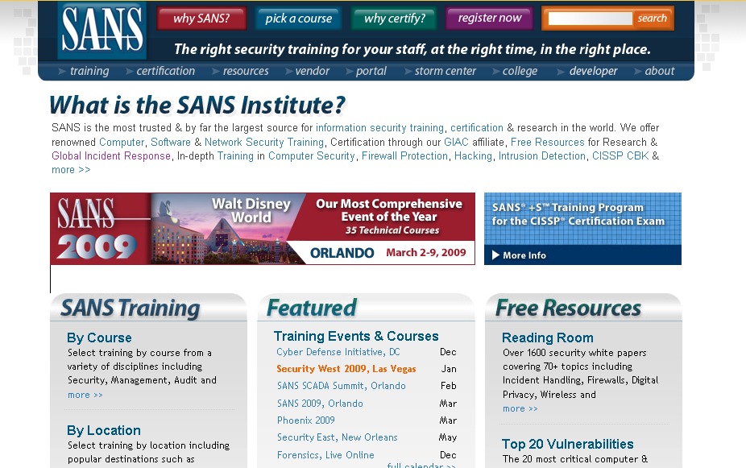
SANS

Slide 70
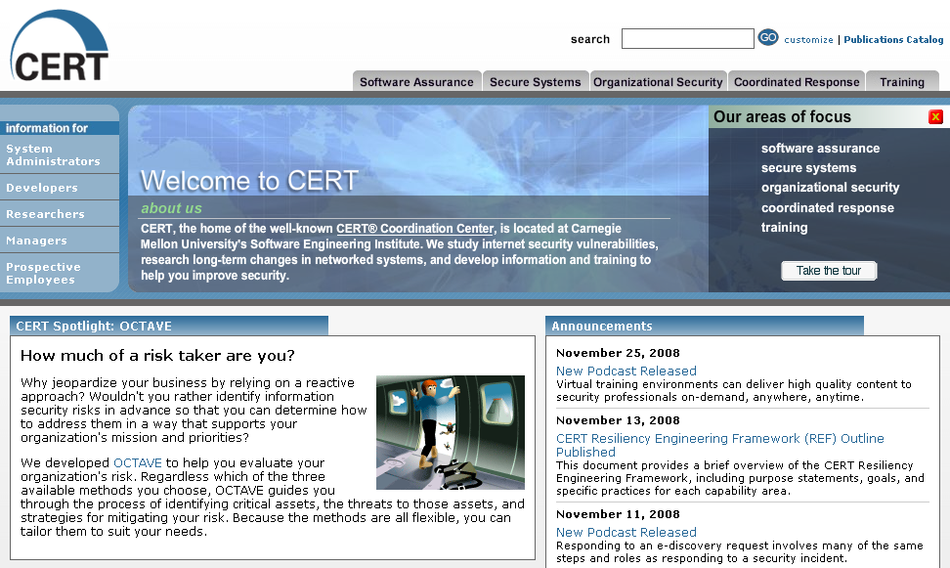
CERT

Slide 71

ISC2
Information security certifications Offered by (ISC)2
Systems Security Certified Practitioner (SCCP)
Certification and Accreditation Professional (CAP)
Certified Secure Software Lifecycle Professional (CSSLP)
Certified Information Systems Security Professional (CISSP)
Notes:
Systems Security Certified Practitioner (SCCP)
Only available to qualified candidates who subscribe to the (ISC)2 code of ethics and pass the SSCP Certification examination based on the relevant SSCP Common Body of Knowledge (CBK). Candidates must also be able to prove at least one-year experience in one of the 7 domains that comprise the SSCP Certification:
Access Controls
Administration
Audit and Monitoring
Risk, Response and Recovery
Cryptography
Data Communications
Malicious Code/Malware
Certification and Accreditation Professional (CAP)
Co-developed by the U.S. Department of State's Office of Information Assurance and (ISC)², the CAP credential is used as a measure of the knowledge, skills and abilities of personnel involved in assessing risk and establishing security requirements, as well as ensuring information systems possess appropriate security measures.
Certified Secure Software Lifecycle Professional (CSSLP)
The newest certification from (ISC)², this is the only certification in the industry that ensures that security throughout the software lifecycle. It centers around seven common bodies of knowledge (CBK).
Secure Software Concepts
Secure Software Requirements
Secure Software Design
Secure Software Implementation/Coding
Secure Software Testing
Software Acceptance
Software Deployment, Operations, Maintenance and Disposal
Certified Information Systems Security Professional (CISSP)
One of the most popular certifications in the network security profession, the CISSP was the first credential in the field of information security, accredited by the American National Standards Institute (ANSI). For CISSP credential, in addition to 5 years of experience, professional experience must be in two or more of 10 defined (ISC)² CISSP domains including:
Access Control
Application Security
Business Continuity and Disaster Recovery Planning
Cryptography
Information Security and Risk Management
Legal, Regulations, Compliance and Investigations
Operations Security
Physical (Environmental) Security
Security Architecture and Design
Telecommunications and Network Security

Slide 72
Network Security Jobs
Network Security Administrator
Risk Analyst
VPN Specialist
Penetration Tester
Network Perimeter/Firewall Specialist
Security Response IDS/IPS Engineer

Slide 73
Network Security Jobs
Examples from Salary.com:
Network Security Administrator
Troubleshoots network access problems and implements network security policies and procedures. Ensures network security access and protects against unauthorized access, modification, or destruction. Requires a bachelor's degree with at least 5 years of experience in the field. Familiar with a variety of the field's concepts, practices, and procedures. Relies on extensive experience and judgment to plan and accomplish goals. Performs a variety of tasks. May lead and direct the work of others. A wide degree of creativity and latitude is expected.
Risk Analyst
Performs risk analysis studies in order to maintain maximum protection of an organization's assets. Investigates any incidences that may result in asset loss and compiles findings in reports for further review. Requires a bachelor's degree and 0-2 years of experience in the field or in a related area. Has knowledge of commonly-used concepts, practices, and procedures within a particular field. Relies on instructions and pre-established guidelines to perform the functions of the job. Works under immediate supervision. Primary job functions do not typically require exercising independent judgment.

Slide 74
Network Security Jobs, 2
Chief Information Security Officer
Responsible for determining enterprise information security standards. Develops and implements information security standards and procedures. Ensures that all information systems are functional and secure. Requires a bachelor's degree with at least 12 years of experience in the field. Familiar with a variety of the field's concepts, practices, and procedures. Relies on extensive experience and judgment to plan and accomplish goals. Performs a variety of tasks. Leads and directs the work of others. A wide degree of creativity and latitude is expected. Typically reports to top management.
Network Perimeter/Firewall Specialist
This position requires Experience and Skills working with perimeter protection devices and network firewalls. The candidate must have experience with PIX Firewalls and MPLS Network experience. Cisco Switch and Router experience is a plus. Experience with Network Transformation and Server Re-IP projects is a definite plus. Other Firewall experience is a definite plus.

Slide 75
Network Security Jobs, 3
Ethical hacker/Penetration Tester
Responsible for testing and improving network and information system security systems. This is a very sensitive hands-on front line position. This person will be working in a team environment. This individual will be performing mostly network and web application ethical hacking assessments on multi-protocol enterprise network and application systems. Duties may include: Requirements analysis and design, scoping of testing activity, vulnerability assessment, assessing tools/script testing, troubleshooting and physical security audits, logical security audits, logical protocol and traffic audits.
Security Response IDS/IPS Engineer
Provides support for the Intrusion Detection/Prevention Service, Host Log Monitoring Service, and Wireless IPS Service associated with Managed Security Services. Must have a well-rounded security background and are responsible for performing extensive troubleshooting of customer issues via Customer Support escalations from the Security Operations Center (SOC) Analysts. This individual performs both infrastructure engineering and customer focused projects to resolve all incidents in timely manner. These needs may involve performing device upgrades, investigating and responding to advanced security threats, and making changes to the security policy of a customer's device.

Slide 76


